Slide 1

Multilingual Education through OCR and AI
Under the guidance of
Dr. Mayuri Molawade

Slide 2
Group Members
Shaikh Mohhammad
Arbaaz Yaseen
Hritik Singh

Slide 3
Requirement Gathering
User Needs Assessment
Stakeholder Consultation
Technology Assessment
Identify language barriers faced by Indian learners.
Understand challenges with learning in English.
Consult with educators, students, and language experts.
Gather insights on language preferences and learning difficulties.
Evaluate AI and OCR solutions for language translation and accessibility.
Assess usability and effectiveness in overcoming language barriers.

Slide 4
Analysis
Language Barrier Identification
User Feedback Evaluation
Technology Suitability Assessment
Analyze data on language proficiency and preferences among Indian learners.
Identify specific challenges faced when learning in English.
Analyze feedback from stakeholders, including educators and students.
Assess user perceptions of existing language learning methods and technologies.
Evaluate AI and OCR solutions for their effectiveness in addressing language barriers.
Analyze the compatibility of selected technologies with educational contexts and user needs.

Slide 5

Problem Identification and Our Solution
Language Barrier Challenge
Our Solution: Multilingual Education Platform
Problem: Many Indian learners face difficulty in learning English due to language barriers.
Solution: Develop a multilingual education platform leveraging AI and OCR technologies

Slide 6

Key Features
Language Translation and Localization
Interactive Learning Resources
Seamless translation of educational content into multiple languages.
Localization of resources to accommodate diverse linguistic preferences.
Engaging multimedia content tailored to different language backgrounds.
Interactive quizzes and gamified learning modules for enhanced engagement.

Slide 7
Workings

Slide 8
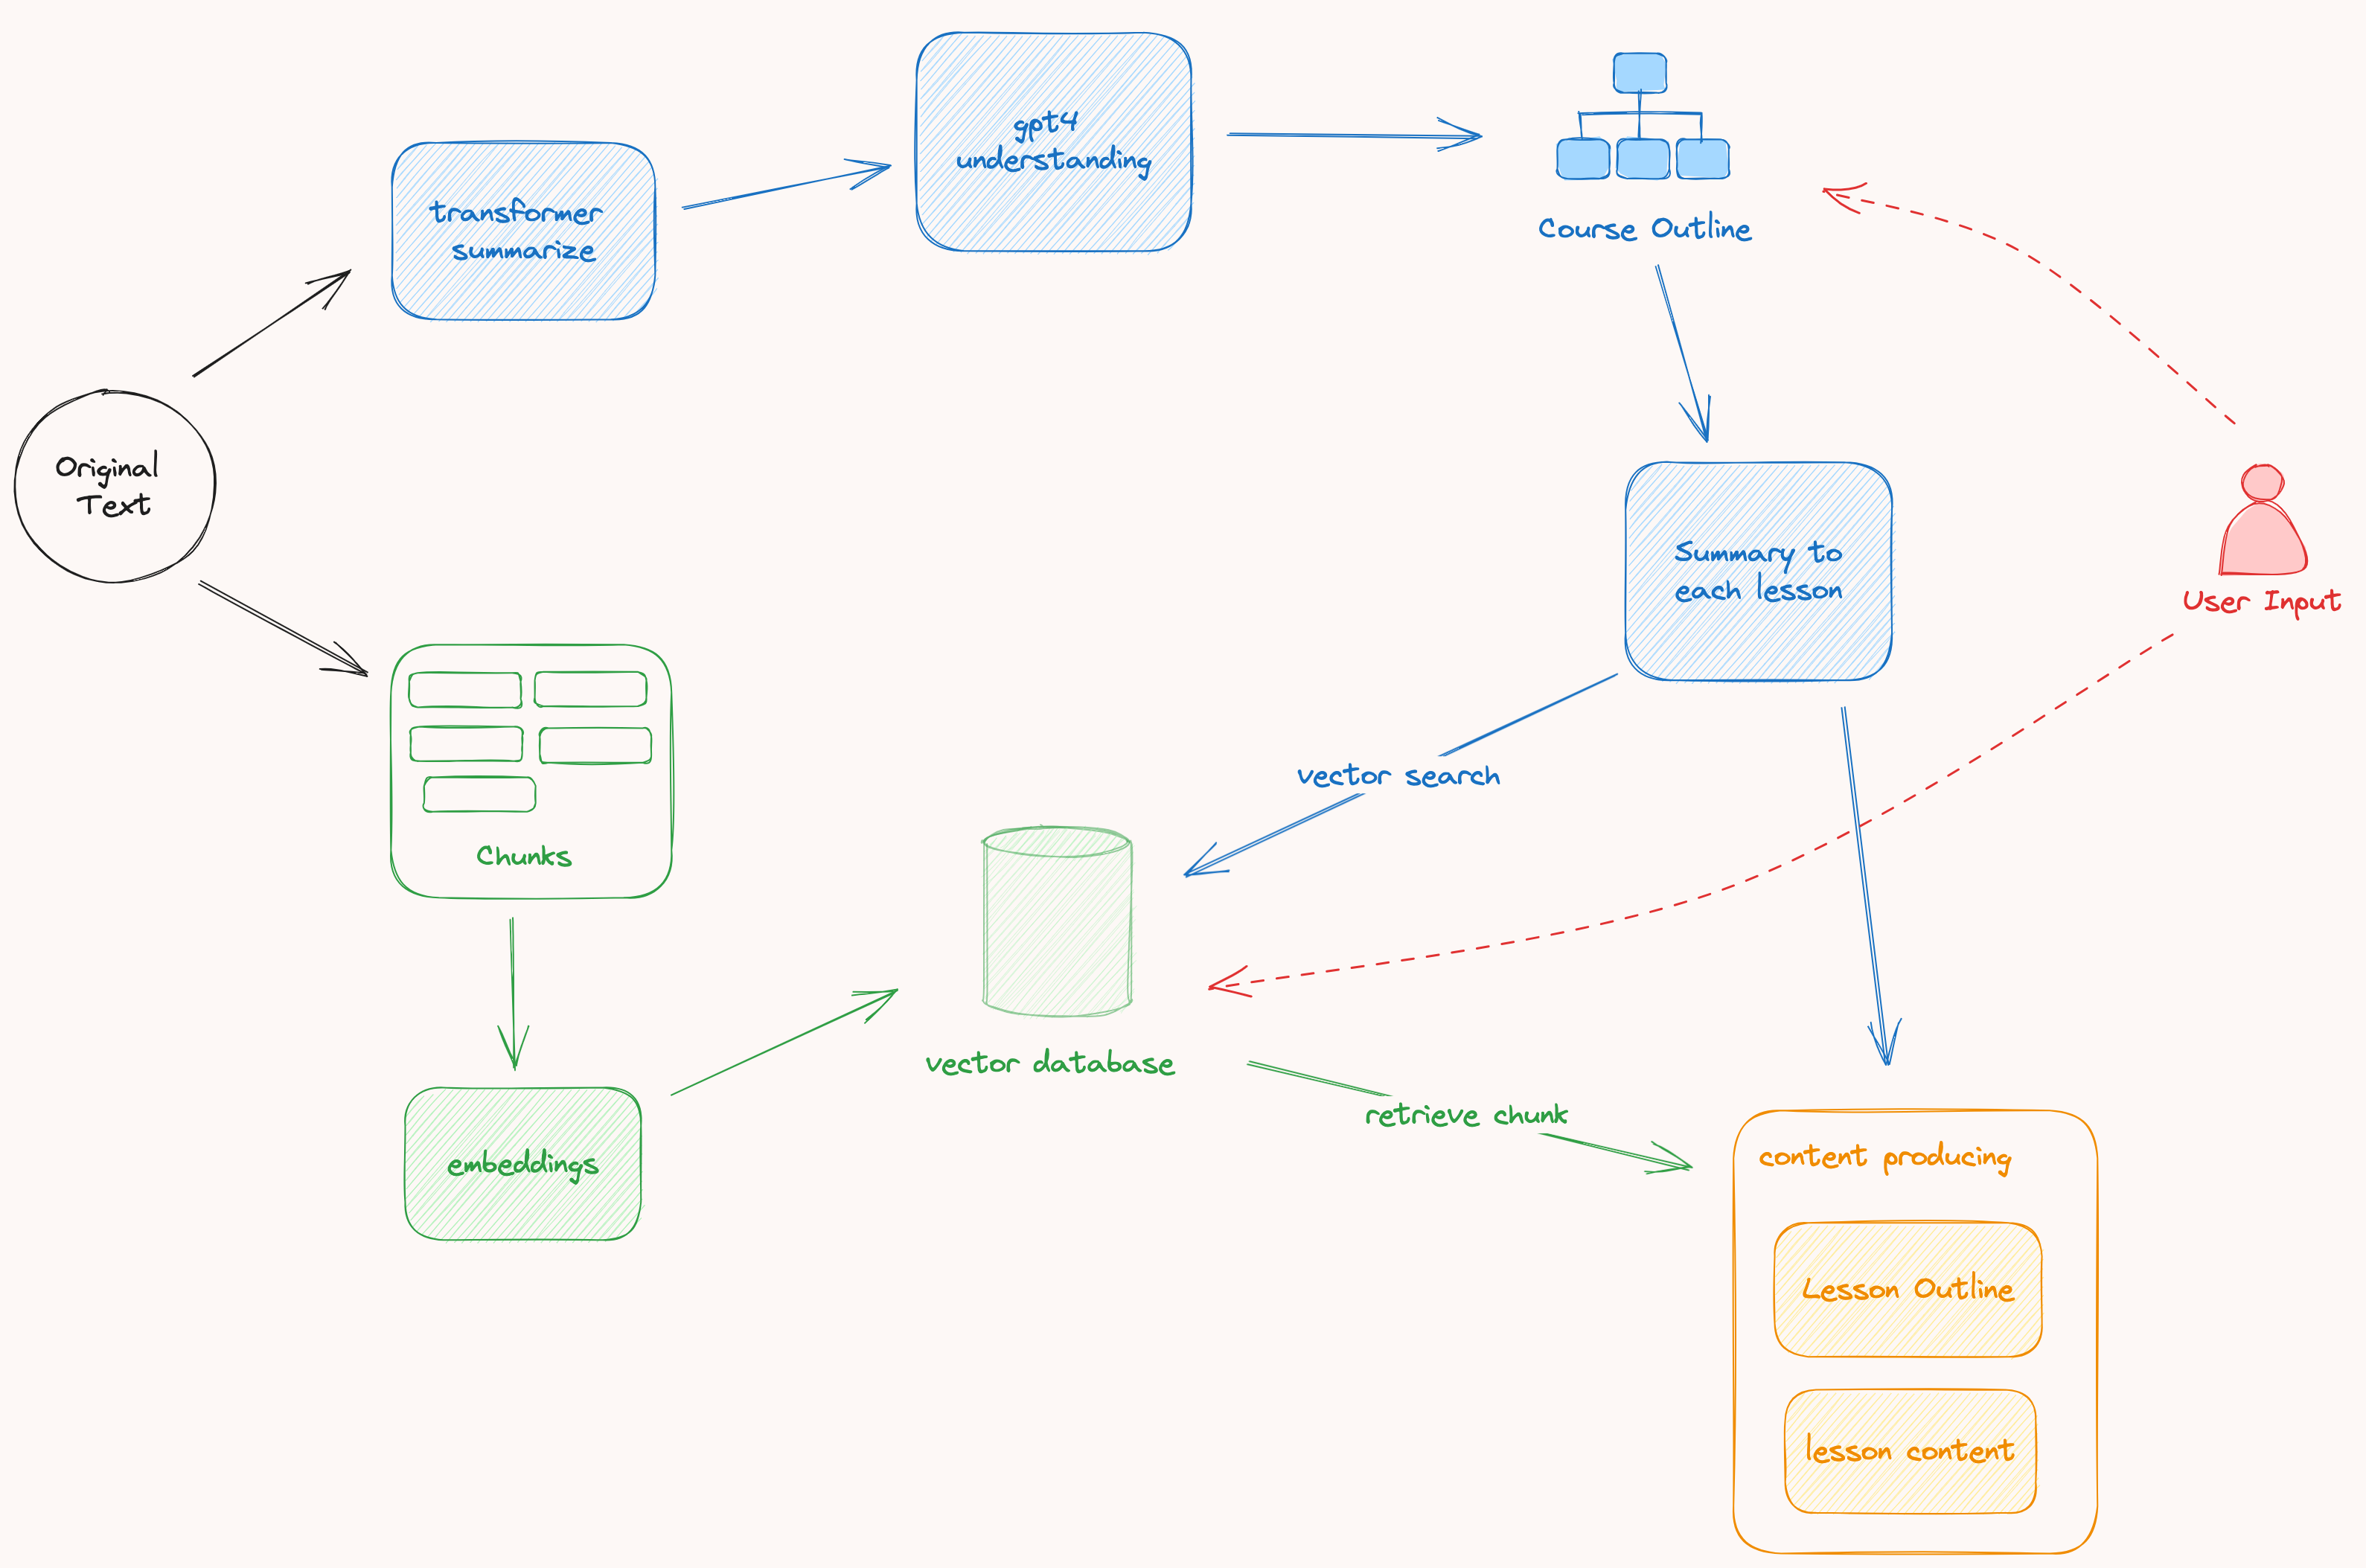

Slide 9
Understanding the Technology
Hugging Face Transformer
GPT-3.5 LLM
Natural Language Toolkit
The Hugging Face Transformer is a powerful natural language processing (NLP) model that uses deep learning techniques to understand and process text in multiple languages.
The GPT-3.5 LLM (Long Language Model) is an advanced text generation model with the ability to generate language-based content, making it a key technology for multilingual education through AI.
The Natural Language Toolkit (NLTK) is an open-source Python library that provides tools for processing and analyzing human language data, enabling effective text parsing and keyword extraction.

Slide 10
Parsing and Keyword Extraction
PDF Parsing
Keyword Extraction
Natural Language Processing
The PDF parsing process involves extracting text content from PDF files, enabling the conversion of PDF-based educational materials into digital text for further analysis and language processing.
The keyword extraction technique involves using natural language processing algorithms to identify and extract the most relevant keywords from parsed PDF content, facilitating the creation of effective multilingual course modules.
Natural Language Processing (NLP) plays a crucial role in the parsing and keyword extraction process, allowing for in-depth analysis of text data and optimization of multilingual education materials.

Slide 11
Course Module Generation
AI-based Module Outline
Language Adaptation
User-centered Learning
Utilizing AI, the system generates comprehensive course module outlines in the user's desired language, offering structured and sequenced learning material based on parsed PDF content.
The AI-driven generation process ensures adaptability to diverse languages, facilitating effective multilingual education while maintaining the coherence and structure of the original educational content.
The module generation empowers users to learn PDF content in a sequential, easy-to-understand manner, supporting their multilingual education needs through innovative AI technologies.

Slide 12
Vector Database Construction Using chromadb
Content Indexing
Faiss Index Utilization
Advanced Content Retrieval
The vector database construction process involves indexing and encoding the parsed educational content, enabling efficient retrieval and matching of course material based on user queries and learning needs.
Leveraging the Faiss index, the system effectively normalizes and organizes content embeddings for optimized database construction, supporting accurate and rapid retrieval of relevant educational materials.
The vector database enhances the learning experience through advanced content retrieval, empowering users to access tailored educational content based on their specific learning requirements and interests.

Slide 13
Course Outline and Content Generation
Keyword-driven Course Outline
Dynamic Content Generation
Semantic Learning Approach
The course outline generation integrates extracted keywords to form a structured learning pathway, offering a comprehensive overview of essential educational concepts and themes for multilingual learning.
The system dynamically generates course content aligned with the outlined modules, ensuring tailored learning materials that cater to users' specific language preferences and educational objectives.
Applying a semantic learning approach, the content generation process fosters enriched multilingual education, enabling users to engage with course materials in their preferred language with semantic relevance and depth.

Slide 14
Output

Slide 15
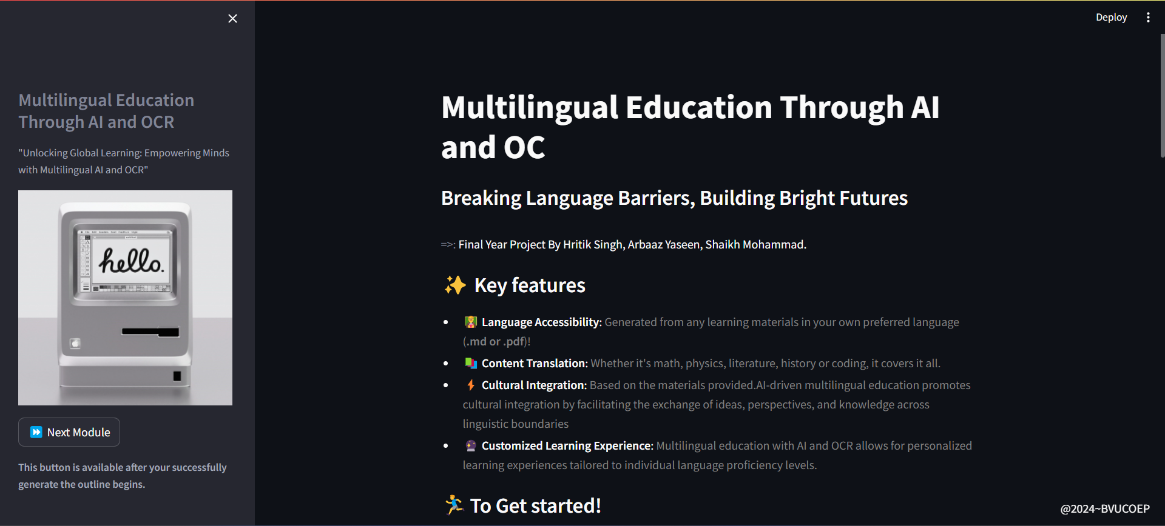
Web Application hosted on Local System: http://localhost:8501/
Side Bar Include title and caption of the project
Main page include a input form to upload the “gpt-api-key” and the pdf

Slide 16
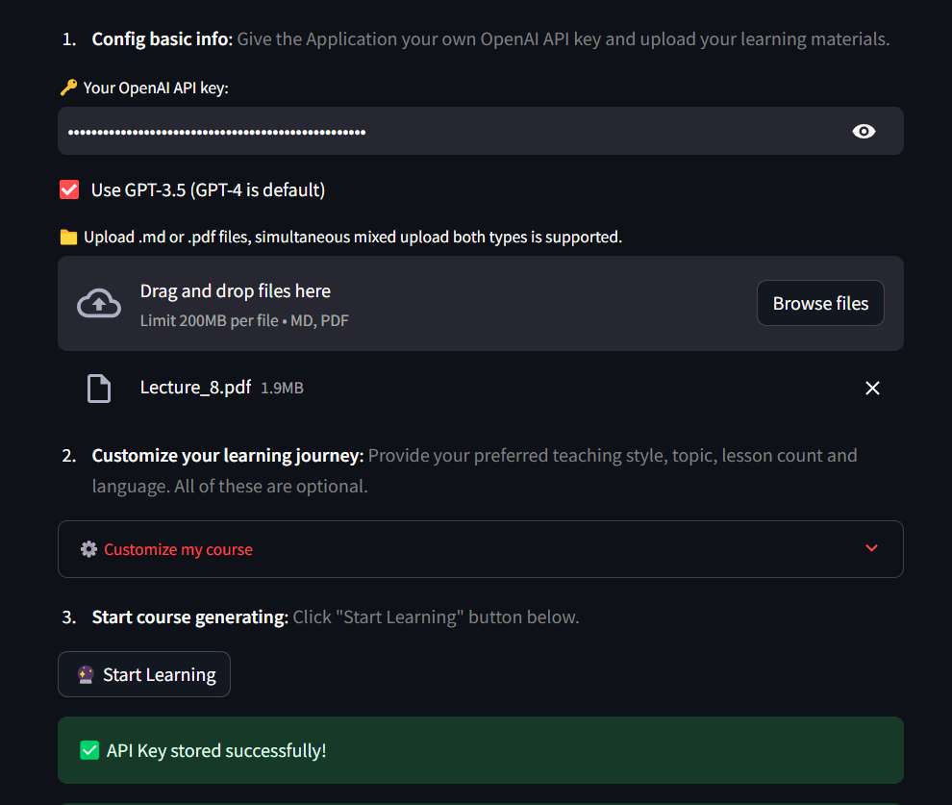
Here as One can See
Input Form include:
API key
Model Selection
PDF file upload option
A customization option for better learning experience
Course Outline Generate Button

Slide 17
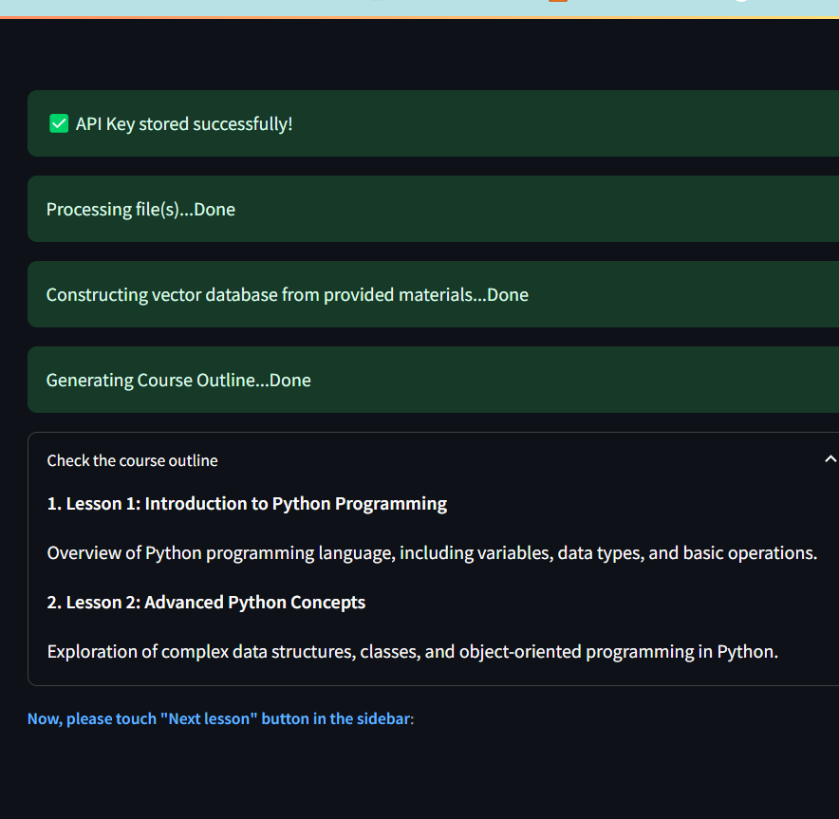
Generate outline Output
Pdf file parsing + vector db index generation
Gpt-turbo-3.5 output after taking the keywords generated by “nltk”

Slide 18
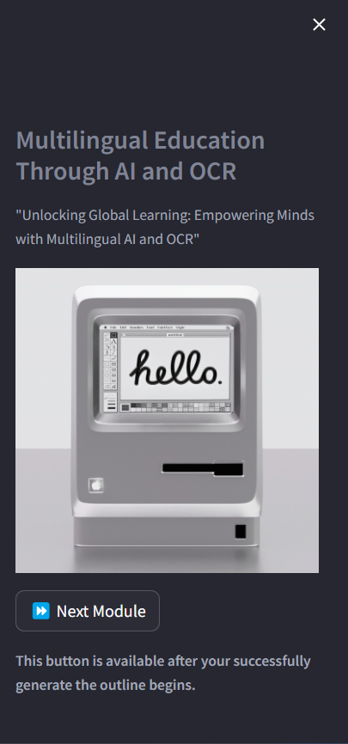

Lesson Generated
After Course outline is generated one can click next module to generate lessons based on course outline of the passed pdf

Slide 19
Summary and Next Steps
Key Insights Recap
Empowering Educational Initiatives
Future Development Prospects
A summary of the presentation's key insights, highlighting the transformative role of OCR and AI in advancing multilingual education and enhancing learning accessibility.
Proposing proactive steps to integrate OCR and AI technologies into educational initiatives, fostering inclusive and diverse multilingual learning environments for global learners.
Exploring the potential avenues for future development and collaborative efforts in leveraging OCR and AI for multilingual education, envisioning a progressive roadmap for enhanced learning experiences.

